Slide 1



Introduction to Student Result Analysis
Analyzing student performance is crucial for identifying areas of strength and improvement, optimizing teaching strategies, and ensuring academic success. This presentation will explore the key steps in gathering, visualizing, and interpreting student data using powerful data analysis tools.
Done by:
160122737180
160122737181
160122737182
Notes:
1

Slide 2
Importance of Analyzing Student Performance
1
Personalized Learning
2
Curriculum Refinement
3
Institutional Improvement
Identify individual student needs and tailor instruction accordingly.
Evaluate the effectiveness of teaching methods and make informed decisions about curriculum updates.
Gain insights to enhance overall academic quality and student outcomes.
Notes:
2

Slide 3
Data Gathering and Preprocessing using Pandas
Data Collection
Data Preprocessing
Feature Engineering
Gather student data from various sources, such as attendance records, test scores, and assignment submissions.
Use Pandas to clean, format, and consolidate the data into a structured format for analysis.
Create new variables from the raw data to uncover hidden insights about student performance.
Notes:
3

Slide 4
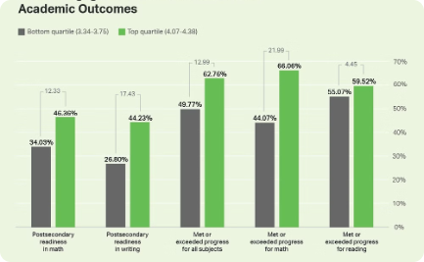
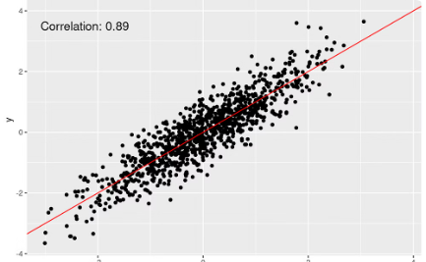
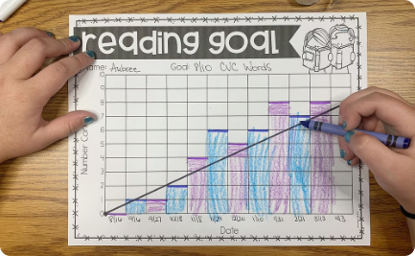
Visualizing Student Data using Matplotlib
Bar Charts
Scatter Plots
Line Graphs
Visualize student performance metrics, such as test scores or assignment grades, using bar charts.
Identify correlations between student variables, like attendance and grades, using scatter plots.
Track individual student progress or class-level trends over time using line graphs.
Notes:
4

Slide 5

Identifying Trends and Patterns in Student Results
1
Outlier Detection
Identify students who are performing significantly above or below the class average, and investigate the underlying causes.
2
Clustering Analysis
Group students with similar academic profiles to uncover patterns and potential subgroups within the data.
3
Correlation Analysis
Examine the relationships between various student attributes, such as attendance, participation, and test scores.
Notes:
5

Slide 6
Analyzing Factors Affecting Student Performance
Socioeconomic Status
Classroom Environment
Explore the impact of family income, parental education, and access to resources on student outcomes.
Assess the influence of teaching methods, classroom dynamics, and peer interactions on student engagement and learning.
Personal Factors
School Support Systems
Understand the role of student motivation, self-efficacy, and overall well-being in academic performance.
Evaluate the effectiveness of academic counseling, tutoring programs, and extracurricular activities in supporting student success.
Notes:
6

Slide 7




Providing Actionable Insights and Recommendations
Targeted Interventions
Curriculum Adjustments
Collaborative Approach
Continuous Improvement
Develop tailored support programs for underperforming students or those facing unique challenges.
Implement changes to teaching methods, course content, and resource allocation based on data-driven insights.
Foster partnerships between teachers, administrators, and families to collectively support student success.
Establish regular data review and feedback loops to monitor the effectiveness of implemented strategies.
Notes:
7

Slide 8
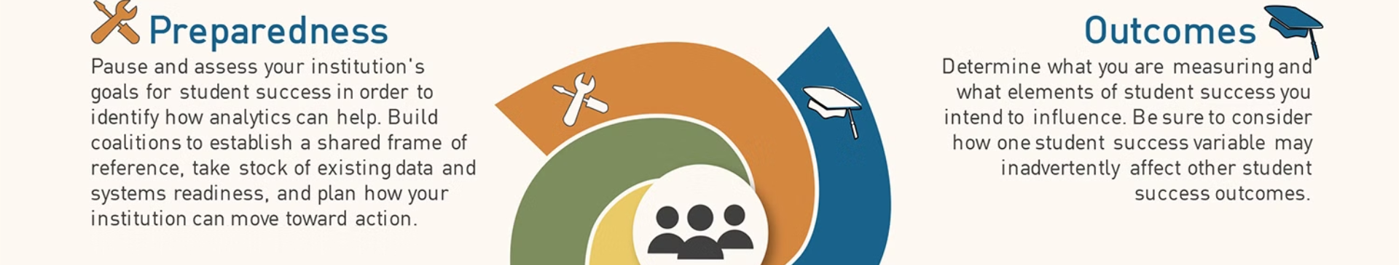
Conclusion and Future Considerations
Effective student result analysis is a critical tool for driving academic excellence and ensuring that every student has the opportunity to reach their full potential. By embracing data-driven insights and a commitment to continuous improvement, educators can empower students to thrive and succeed.
Notes:
8

